Slide 1

Lecture 2: MNIST Classification
김지한 (카이스트)
8.20.2021

Slide 2
Motivation
The motivation of this lecture is to get hands-on experience of using Python through Jupyter-Notebook to tackle machine learning related problems.
For this purpose, we will be using Python as our programming language.
Python will run through the Jupyter-notebook in the Anaconda environment

Slide 3

Sample “Hello World” Problem – Recognizing a Handwritten Number
Number image
Neural Network
It’s a “5”
Label: 5
Number classes: 0 to 9 for the simplification
Question? How do we teach the neural network to accurately recognize different images of numbers?

Slide 4
One Naive Way
Naïve approach: We take a look at the number “5” and try to find the “essence” of it.
Example: 5 can be divided as follows.
Bottom part: “C” that is rotated sideways
top part: “horizontal”
Middle left part: “vertical”

Slide 5
One Naive Way – Explicit Programming
By explicit programming, we can try to describe the image 5. Example
If (top part = horizontal AND middle left part = vertical AND bottom part = sideways C)
then image = 5
else image != 5
But we need to then define what it means by “top part”, “horizontal”, etc.
e.g. top part = area where top ¼ of the image is located.
But what if the “5” is written at he bottom of the image?
But what if “5” is rotated 30 degrees?
Explicit programming leads to so much complication and so many exceptions that it is just not worthwhile.
We will instead use machine learning to solve this problem.

Slide 6
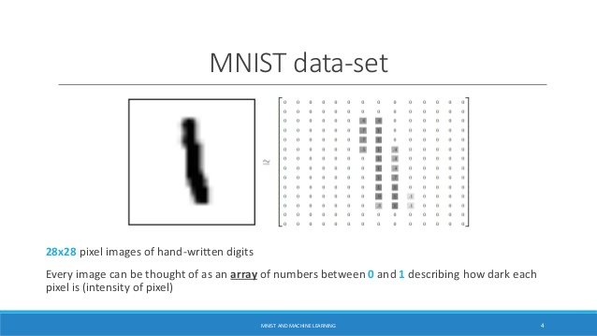
Step #1: Discretization of Input Image
The given image can be divided into small pixels
As such, we can represent the input image as a matrix
Each element would be 0 if white, 1 if black (other numbers between 0-1 can represent different greyish shade)
As such, the graphical image gets transformed into numbered matrices to represent

Slide 7
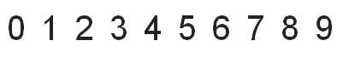
Step #2: Representation of Output
Let’s assume for this problem that there are 10 numbers.
Our output is a scalar of size 1.
Each of the vector element correspond to integers 0, 1, 2, ..9

Slide 8
Summary of the Neural Network Model
Summary thus far.
Neural Network
It’s a “5”
Number image
Input: NxN matrix (humans provide), for this problem
we will assume N = 28. 28x28 = 784
Output: Scalar number

Slide 9
“Training” the Neural Network
In practice, for this problem and other machine learning problems, we “train” the neural network with large number of data (i.e. big data). In this case, the big data = large number of different number images.
Training means we provide different images and link each image to the correct output scalar.
Let’s say that we train the neural network with 10,000 images.
Image | Input Matrix | Output Scalar
Image #1 | [28x28]₁ | 7
Image #2 | [28x28]₂ | 5
… | … | …
Image #10,000 | [28x28]_{10,000} | 3

Slide 10
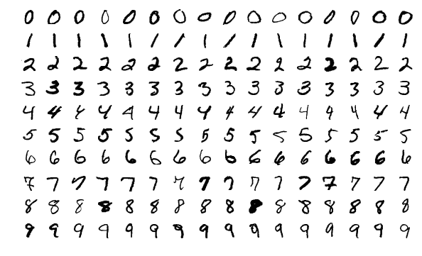
Numbered Image Data are Available for Free
MNIST Database: 60,000 training set examples of handwritten digits. 10,000 test set examples.
http://yann.lecun.com/exdb/mnist/
One thing great about the MNIST data is that we also have answers (image #x is number y, to all 70,000 images), which means we do not have to do this burdensome work ourselves (labeled data are great!).

Slide 11
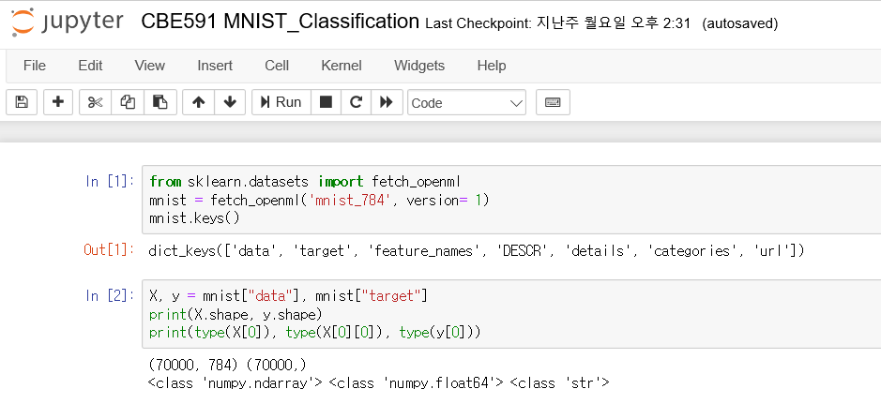

MNIST Data Download
We will be using “MNIST dataset” which contains 70,000 images of digits handwritten. (0 to 9)
This dataset is already well preprocessed and each image is 28*28 (784) pixels.
“Name of my python script”
“Type the contents and press shift+Enter to see outputs”

Slide 12
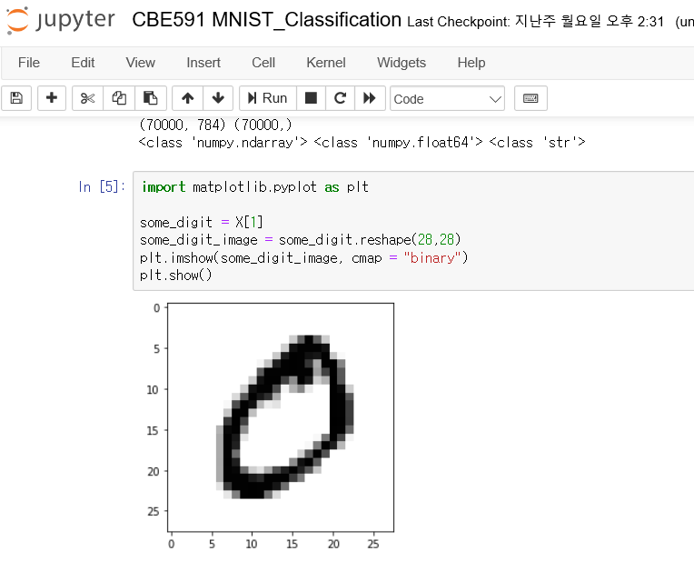
MNIST Data Download
Now we have Data contained in variable “X” and target(answer) contained in variable “y”
Let’s look at the second instance of the data “X”
“Instance starts from 0, thus 1 means second instance of X”

Slide 13
Preprocessing the MNIST Data
“MNIST dataset” is already pre-processed well (e.g. each image is nicely mapped to a 28x28 matrix) and we do not have to do much work in preprocessing here.
First, labels in “y” have type “string”, but usually we prefer numbers.
Second, we should split dataset into train_dataset and test_dataset.
Indeed, the “MNIST dataset” is already well divided into two groups, with the preceding 60,000 being the training data set and last 10,000 being the test data set.

Slide 14

MNIST: (1) Binary Classifier
Before proceeding to classify all 10 numbers, let’s try a simpler problem.
We will use binary classifier to differentiate 5 versus not 5 (i.e. 0, 1, 2, 3, 4, 6, 7, 8, 9).
Since we do not have labels for this, we will modify the original label in our data set (“True” for 5 and “False” for not-5).
We will use an existing classifier model: Scikit-Learn’s SGDClassifier class.
Now we have trained machine learning system named “sgd_clf”
Name of the python libarary
A Class included in the library

Slide 15

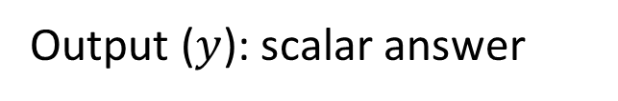
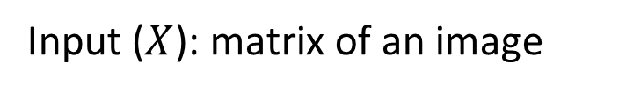
MNIST: (1) Binary Classifier
$$y=f_{sgd_clf}\left(X\right)$$
sgd_clf
[1]
Input ($X$): matrix of an image
Output ($y$): scalar answer
sgd_clf can be seen as a good black box model with bunch of parameters
The parameters are optimized to accurately map numbered image to its corresponding answer

Slide 16
(1) Binary Classifier – How to Check its Performance?
Before actually applying “sgd_clf” to the test_dataset, we will check the performance of the chosen model “SGD” with the train_dataset.
Let’s perform one sanity check before applying our trained model to the test set.
We will divide up the training set into k groups. And we will follow the following prescription (https://machinelearningmastery.com/k-fold-cross-validation/).
Shuffle the dataset randomly.
Split the dataset into k groups
For each unique group:
Take the group as a hold out or test data set
Take the remaining groups as a training data set
Fit a model on the training set and evaluate it on the test set
Retain the evaluation score and discard the model
Summarize the skill of the model using the sample of model evaluation scores

Slide 17
(1) Binary Classifier – Cross Validation
Cross-Validation (ex MNIST dataset)
Just like we trained our model through train dataset, we make clone models and train it through training-fold and make prediction for test-fold
By repeating above work to all 3-fold, we obtain prediction label for whole Train dataset
60,000
10,000
Train dataset
Test dataset
20,000
40,000
3-fold
cross validation
Training-fold
Test-fold

Slide 18
(1) Binary Classifier – Cross Validation
Train dataset into 3-fold
Cross-Validation (ex MNIST dataset)
Now, y_train_pred contains the predicted output (5 or Not 5) from three different machine learning models that used a subset of the training set to arrive at the answer.
And as such, we have (1) predicted output: y_train_pred (vector of length 60,000) and (2) real output: y_train_5 (vector of length 60,000)
Naturally, we want to compare our prediction with the true solutions to see how we have performed.
How would we do this?
Model to make clone
Train dataset as input
Notes:
Confusion Matrix, precision, recal에 대해서는 줄글로 모두 설명하기보다는 그림을 통해 교수님이 말로 설명하시는 것이 좋지 않을까 싶습니다.
그림은 hands-on 머런 교재에 있는 그림입니다.

Slide 19
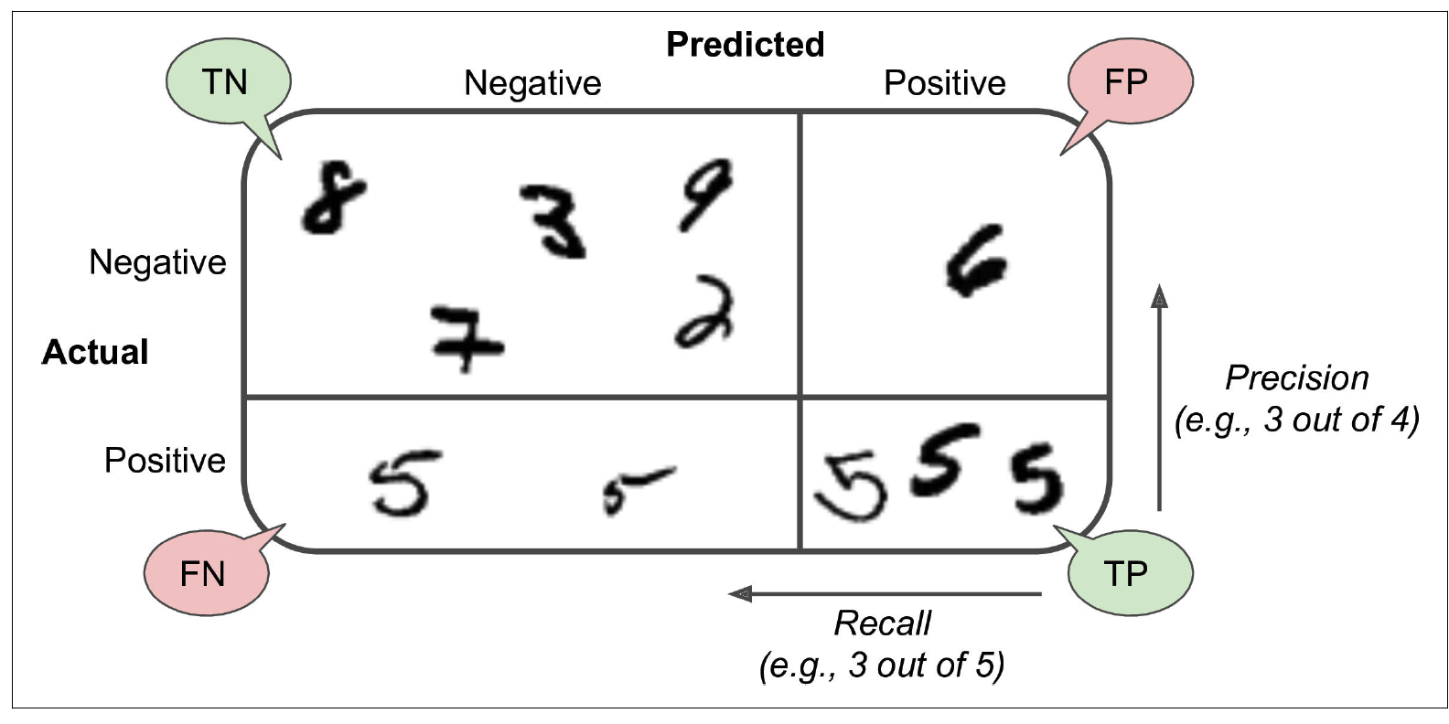
(1) Binary Classifier – Confusion Matrix
In our modified example of binary classification, there are four outcomes.
Image is 5 -> you answer 5 correctly (true positive, TP)
Image is 5 -> you answer incorrectly (false negative, FN)
Image is not 5 -> you answer not 5 correctly (true negative, TN)
Image is not 5 -> you answer incorrectly (false positive, FP)
The following four cases can be summarized as the “confusion matrix” below.
Notes:
Confusion Matrix, precision, recal에 대해서는 줄글로 모두 설명하기보다는 그림을 통해 교수님이 말로 설명하시는 것이 좋지 않을까 싶습니다.
그림은 hands-on 머런 교재에 있는 그림입니다.

Slide 20
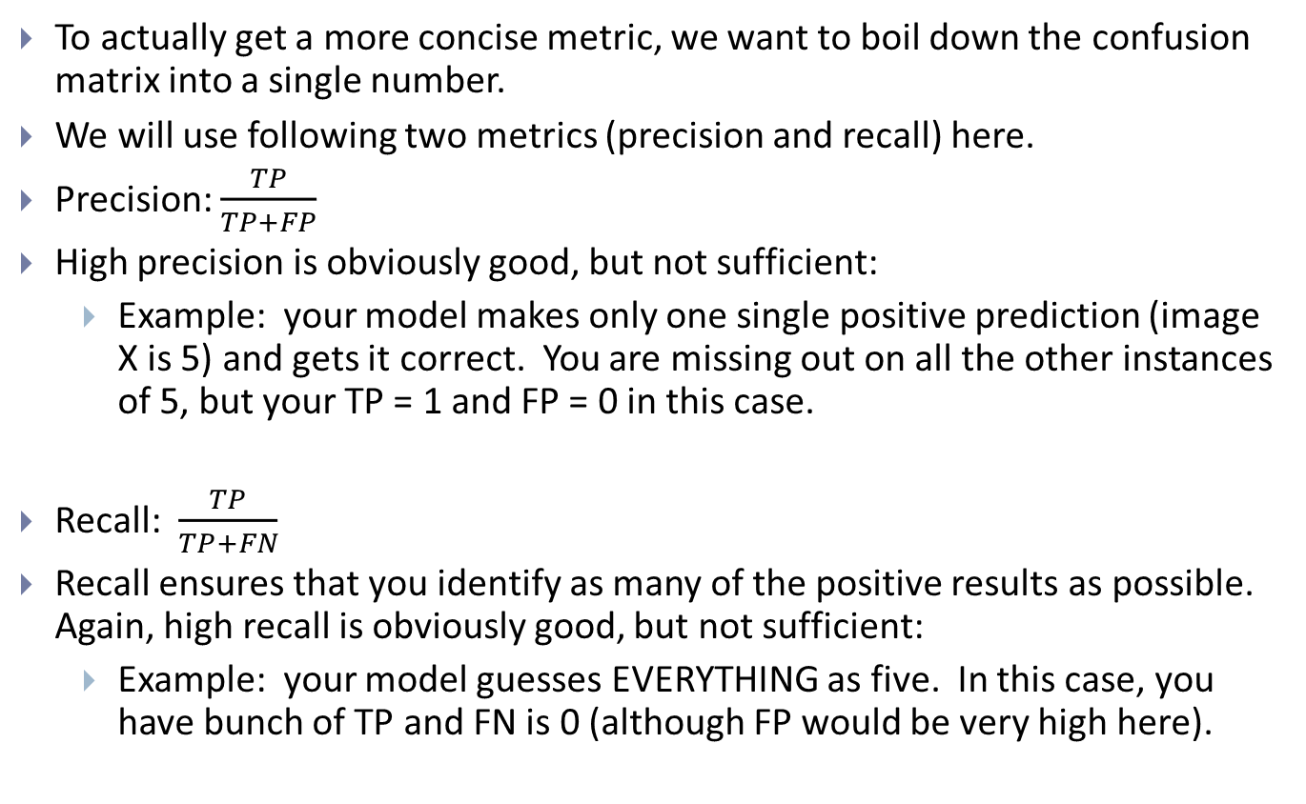
(1) Binary Classifier – How to Check its Performance?
To actually get a more concise metric, we want to boil down the confusion matrix into a single number.
We will use following two metrics (precision and recall) here.
Precision: $\frac{TP}{TP+FP}$
High precision is obviously good, but not sufficient:
Example: your model makes only one single positive prediction (image X is 5) and gets it correct. You are missing out on all the other instances of 5, but your TP = 1 and FP = 0 in this case.
Recall: $\frac{TP}{TP+FN}$
Recall ensures that you identify as many of the positive results as possible. Again, high recall is obviously good, but not sufficient:
Example: your model guesses EVERYTHING as five. In this case, you have bunch of TP and FN is 0 (although FP would be very high here).

Slide 21

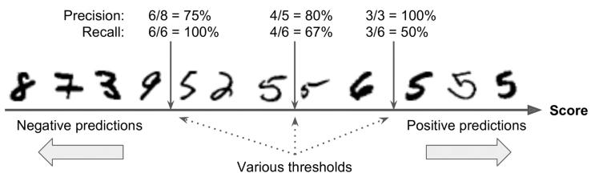
(1) Binary Classifier – Precision & Recall and Trade-off
Confusion matrix, Precision & Recall score
Precision/Recall Trade-off
» [[53892 687]
[ 1891 3530]]
» 0.8370879772350012
» 0.6511713705958311
Notes:
첫 threshold는 0으로 지정되어있음. 모델에서 각 instance하다 점수를 부여하고 그 점수가 threshold를 넘으면 positive prediction으로 안넘으면 negative prediction으로 처리함.
따라서 위 그림에서 보듯 trade-off 경향성이 생김.

Slide 22
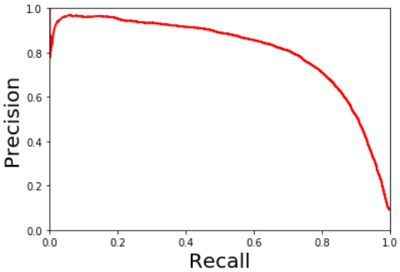
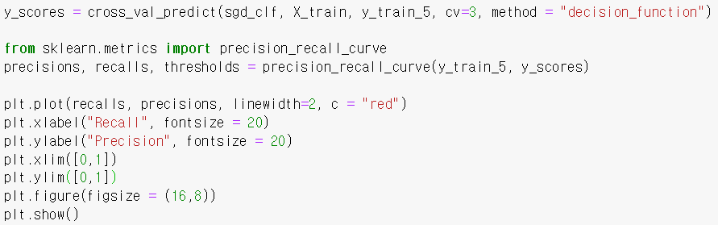
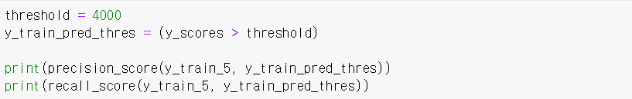
(1) Binary Classifier – Precision & Recall
Every instance has score given from model
Precision/Recall Trade-off
Changing threshold
Default is Zero
True when instance’s score
is larger than threshold
» 0.9085523880044428
» 0.4526840066408412
Notes:
Threshold가 변함에 따라 precision, recall curve가 그려짐. 그림에서도 trade-off 경향성이 보임. 단조 감소가 아닌 것에 대한 이유는 p95페이지에 추가로 설명이 있습니다.
Threshold의 defaul는 0, threshol가 커지면 precision 값은 커지고 recall 값은 작아지는 경향을 보임.

Slide 23
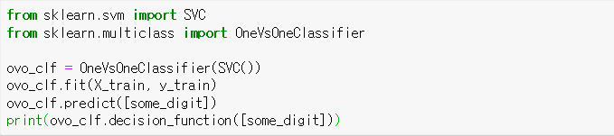
MNIST: (2) Multiclass Classification
Performing multiclass classification, there are largely 2 ways
Utilizing Binary classification (ex : SVM)
OvR : one verses rest, in case of MNIST we should conduct 10 binary classification and sum all (ex : 1vs Rest, 2vs Rest..)
OvO : one verses one, in case of MNIST we should conduct 45 binary classification and sum all (ex: 10 CHOOSE 2)
Just use models that support multiclass classification (ex : SGD)
Binary classifier for multiclass classification
Will take very long time, since
conducting 45 binary classification
Recommend to skip this cell

Slide 24

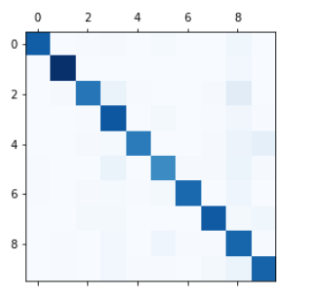
(2) Multiclass Classification
Using models that directly support multiclass classification
Confusion matrix & Error analysis
» [0]
» [[ 14390.59839396 -36919.31719967 -9811.47434817 -8054.56345089 -21825.25725463
-11313.62371972 -23649.39025808 -15986.78463914 -3798.52944589 -10635.46503726]]
This time, we are not making validation
On “train dataset”, But testing directly
on “test dataset”

Slide 25
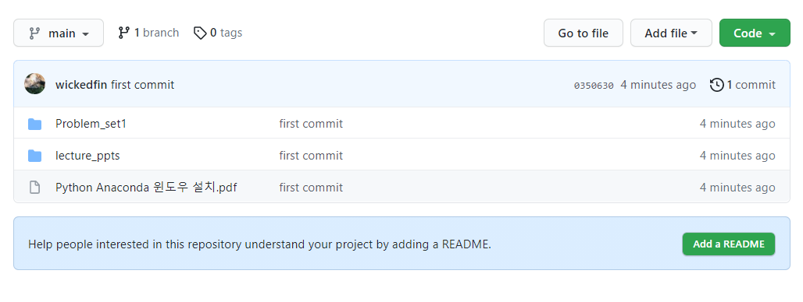
Anaconda Download
https://github.com/Molsim-Group/20210820_Lecture
You can get the guideline to download and install anaconda for window os

Slide 26
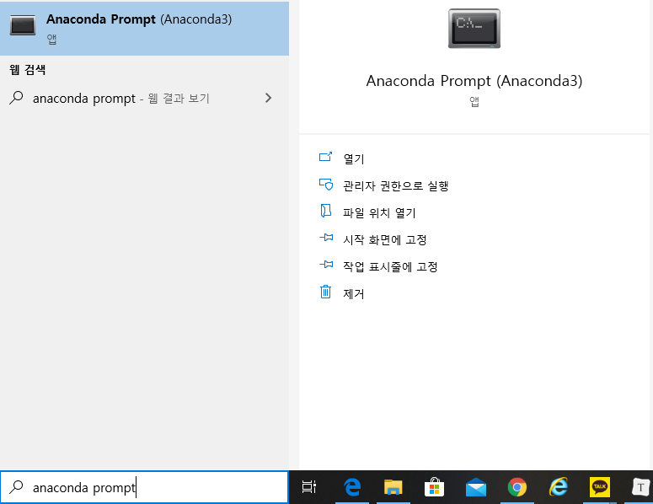
Package download
Most Python Libraries to be used in class are already installed.
If not, install via following below.
» execute “anaconda prompt”
» type command
$ pip install library_name (ex numpy)
$ conda install library_name (ex numpy)
» specific to this lecture
$ conda install tensorflow
$ pip install --user scikit-learn==0.22.1

Slide 27
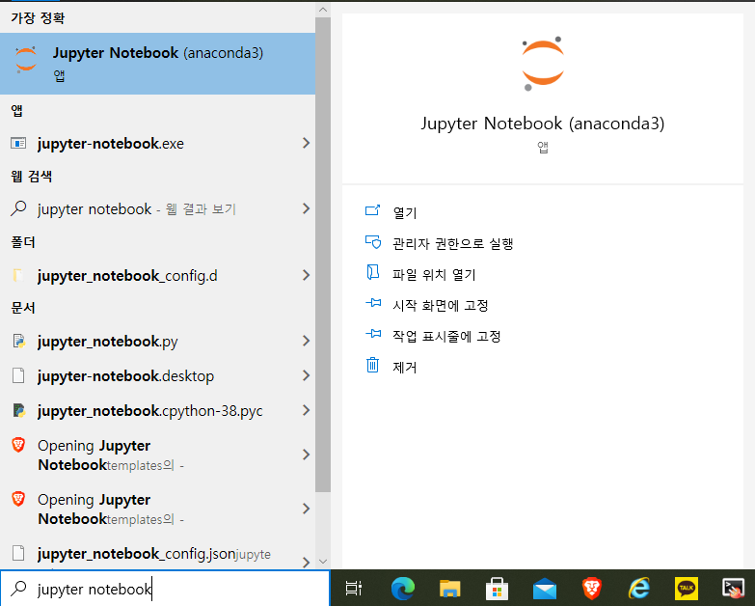
Jupyter-notebook - Execution
Let’s simply begin our process by printing “Hello World”
Search and execute “jupyter notebook”

Slide 28
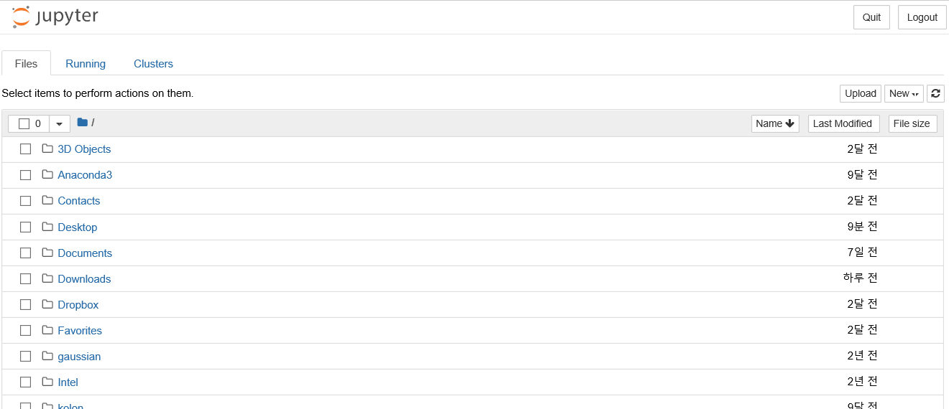
Jupyter-notebook - Execution
Once Jupyter-notebook is launched, you will see the folder list of your computer
I will create a working folder on my desktop (바탕화면)
“Click”

Slide 29
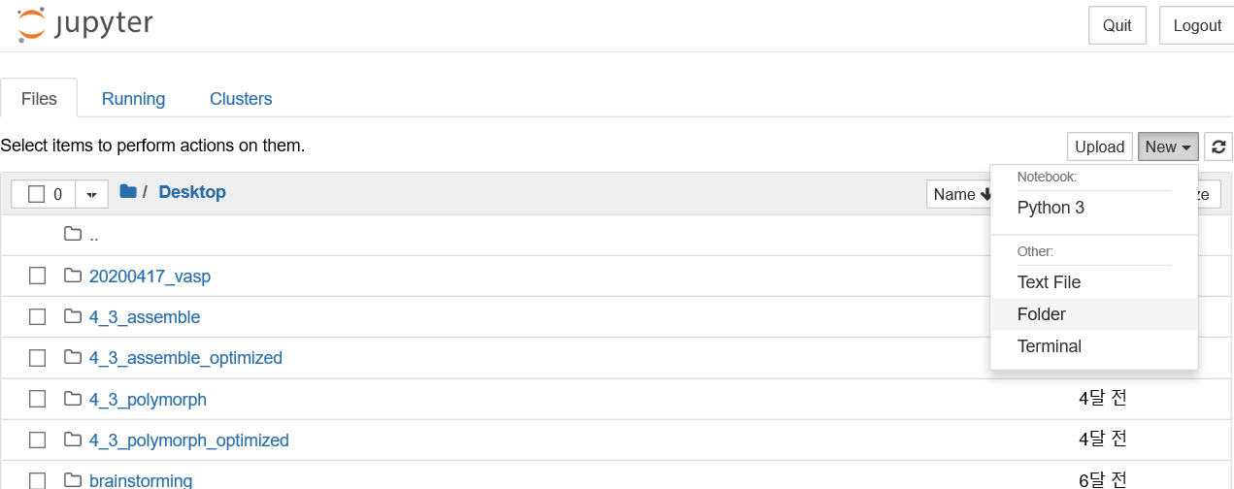
Jupyter-notebook - Execution
Click “New” ⇒ Click “Folder”
Rename your Folder from “Untitled Folder” to whichever you want
I named it as “Test”

Slide 30
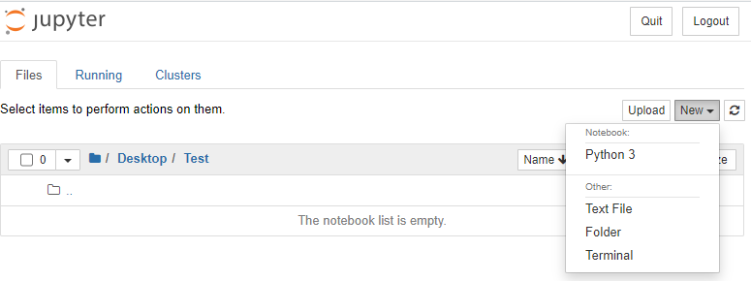
Jupyter-notebook - Execution
This time, we will create a python working space.
Click “New” ⇒ Click “Python 3” (number implies version)

Slide 31
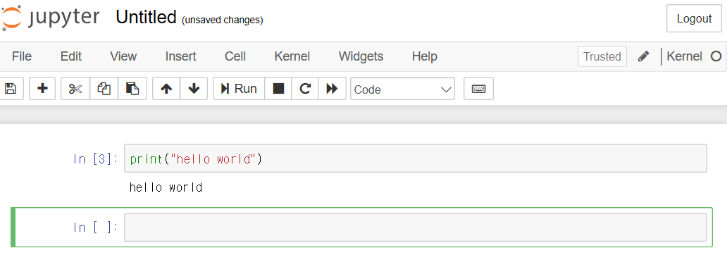
Jupyter-notebook – “Hello World”
Okay, now we are ready to code.
In Jupyter-notebook you can execute each of the cells independently.
Type print(“hello world”) and press shift+Enter to execute the cell
“Click to change the name of python script”
“These are cells.
Press Enter to create a new line
Press shift+Enter to execute the cell”

Slide 32
Jupyter-notebook – “Hello World”
Some more features can be seen below.
Once this is finished, let’s try to tackle a more complicated example: accurately recognizing numbered images.
“You can restart whole script by clicking Kernel ⇒ Restart”
“delete selected cell”
“add new cell”
“save python script”

